Slide 1
AI for Medicine
Lecture 1: Introduction
January 09, 2023
Mohammad Hammoud
Carnegie Mellon University in Qatar

Slide 2
Outline
Introduction
What is AI?
Administrivia
AI Applications in Medicine

Slide 3
On the Verge of Major Breakthroughs
Artificial Intelligence (AI) has been moving extremely quickly in the last few years, demonstrating a potential to revolutionize every aspect of our lives
Work
Economy
Medicine
Mobility

Slide 4
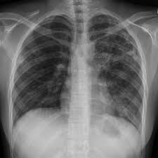
But, What is AI?
AI can be broadly defined as technology that can learn and produce intelligent behavior
Input
Output
An AI Process
Pixels:
“Tuberculosis”
Computer Vision

Slide 5
But, What is AI?
AI can be broadly defined as technology that can learn and produce intelligent behavior
Input
Output
An AI Process
“Four kids are playing with a ball”
Pixels:
More than just a category about the image!
Computer Vision

Slide 6
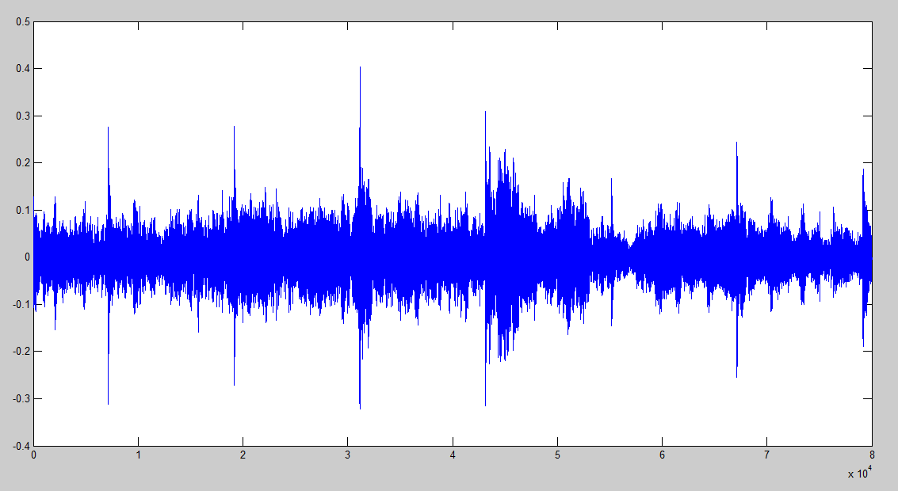
But, What is AI?
AI can be broadly defined as technology that can learn and produce intelligent behavior
Input
Output
An AI Process
Audio Clip:
“I feel some eye pain”
Speech Recognition

Slide 7
But, What is AI?
AI can be broadly defined as technology that can learn and produce intelligent behavior
Input
Output
An AI Process
Text:
“Hello, how are you?”
“Bonjour, comment allez-vous”
Machine Translation

Slide 8
But, What is AI?
Think of this as incoming impulses (input) passed from one neuron (AI process) to the next, if any, and finally generating an output
Input
Output
AI process, which is essentially a mathematical function-- more on this next week

Slide 9
But, What is AI?
You can connect as many of these neurons as needed, resulting in what is called a neural network (a branch of AI)
The more layers you add, the deeper it becomes. Deep ones are referred to as deep neural networks or deep learning (DL) models

Slide 10
But, What is AI?
Subsequently, you can train your DL model
Pneumonia
Tuberculosis
Tuberculosis
Example 1

Slide 11
But, What is AI?
Again, with a different known example
Pneumonia
Tuberculosis
Tuberculosis
Example 2

Slide 12
But, What is AI?
Yet again, with yet another different known example
Pneumonia
Tuberculosis
Tuberculosis
Repeat until it learns the patterns
of Tuberculosis (and Pneumonia) in
input images
Example 3

Slide 13
But, What is AI?
After training your DL model, you can use it to infer what an unknown image may show
Pneumonia
Tuberculosis
Tuberculosis
?

Slide 14
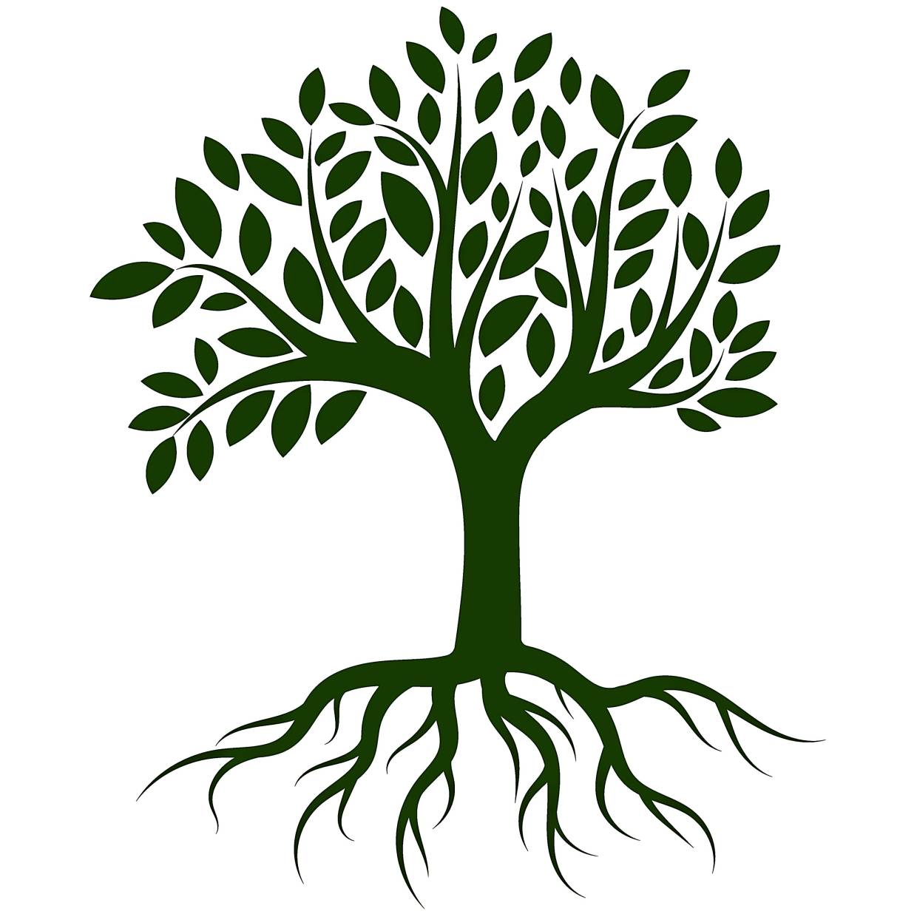
But, What is AI?
DL is just a branch of machine learning, which is a branch of AI
Deep Learning (DL)
Machine Learning (ML)
Artificial Intelligence (AI)
AI
ML
DL
Computer Science
Math
Physics
Chemistry
Biology

Slide 15
Outline
Introduction
What is AI?
Administrivia
AI Applications in Medicine

Slide 16
Objectives
This course will:
Demystify major AI concepts for you (e.g., machine learning, neural networks, Bayesian networks, etc.,)
Take you through a journey of AI applications in medicine
Allow you to navigate several societal issues and ethical concerns that surround AI

Slide 17
Learning Outcomes
After finishing the course, you will be able to:
LO # | Description
1 | Define AI and discuss what AI can and cannot do
2 | Recognize various AI applications in medicine and describe how they are transforming healthcare
3 | Appreciate the power of big data in enabling AI and describe the different types of data representations
4 | Recognize the power of AI algorithms in solving medical problems and discuss how they can be applied in the medical field
5 | Describe different AI concepts, including machine learning, deep learning, recommendation systems, ranked retrievals, and probabilistic graphical models, among others
6 | Apply some AI techniques to solve real-world medical problems (optional)
7 | Discuss several societal issues and ethical concerns surrounding AI
LO # | Description
1 | Define AI and discuss what AI can and cannot do
2 | Recognize various AI applications in medicine and describe how they are transforming healthcare
3 | Appreciate the power of big data in enabling AI and describe the different types of data representations
4 | Recognize the power of AI algorithms in solving medical problems and discuss how they can be applied in the medical field
5 | Describe different AI concepts, including machine learning, deep learning, recommendation systems, ranked retrievals, and probabilistic graphical models, among others
6 | Apply some AI techniques to solve real-world medical problems (only for CMU-Q students)
7 | Discuss several societal issues and ethical concerns surrounding AI
LO # | Description
1 | Define AI and discuss what AI can and cannot do
2 | Recognize various AI applications in medicine and describe how they are transforming healthcare
3 | Appreciate the power of big data in enabling AI and describe the different types of data representations
4 | Recognize the power of AI algorithms in solving medical problems and discuss how they can be applied in the medical field
5 | Describe different AI concepts, including machine learning, deep learning, recommendation systems, ranked retrievals, and probabilistic graphical models, among others
6 | Apply some AI techniques to solve real-world medical problems (optional)
7 | Discuss several societal issues and ethical concerns surrounding AI
LO # | Description
1 | Define AI and discuss what AI can and cannot do
2 | Recognize various AI applications in medicine and describe how they are transforming healthcare
3 | Appreciate the power of big data in enabling AI and describe the different types of data representations
4 | Recognize the power of AI algorithms in solving medical problems and discuss how they can be applied in the medical field
5 | Describe different AI concepts, including machine learning, deep learning, recommendation systems, ranked retrievals, and probabilistic graphical models, among others
6 | Apply some AI techniques to solve real-world medical problems (only for CMU-Q students)
7 | Discuss several societal issues and ethical concerns surrounding AI
LO # | Description
1 | Define AI and discuss what AI can and cannot do
2 | Recognize various AI applications in medicine and describe how they are transforming healthcare
3 | Appreciate the power of big data in enabling AI and describe the different types of data representations
4 | Recognize the power of AI algorithms in solving medical problems and discuss how they can be applied in the medical field
5 | Describe different AI concepts, including machine learning, deep learning, recommendation systems, ranked retrievals, and probabilistic graphical models, among others
6 | Apply some AI techniques to solve real-world medical problems (only for CMU-Q students)
7 | Discuss several societal issues and ethical concerns surrounding AI
LO # | Description
1 | Define AI and discuss what AI can and cannot do
2 | Recognize various AI applications in medicine and describe how they are transforming healthcare
3 | Appreciate the power of big data in enabling AI and describe the different types of data representations
4 | Recognize the power of AI algorithms in solving medical problems and discuss how they can be applied in the medical field
5 | Describe different AI concepts, including machine learning, deep learning, recommendation systems, ranked retrievals, and probabilistic graphical models, among others
6 | Apply some AI techniques to solve real-world medical problems (only for CMU-Q students)
7 | Discuss several societal issues and ethical concerns surrounding AI
LO # | Description
1 | Define AI and discuss what AI can and cannot do
2 | Recognize various AI applications in medicine and describe how they are transforming healthcare
3 | Appreciate the power of big data in enabling AI and describe the different types of data representations
4 | Recognize the power of AI algorithms in solving medical problems and discuss how they can be applied in the medical field
5 | Describe different AI concepts, including machine learning, deep learning, recommendation systems, ranked retrievals, and probabilistic graphical models, among others
6 | Apply some AI techniques to solve real-world medical problems (only for CMU-Q students)
7 | Discuss several societal issues and ethical concerns surrounding AI

Slide 18
Structure
6 units, 1 lecture per week
2 tools: Piazza and Gradescope
No textbook
Slides are self-contained, but you are encouraged to take notes
All course material will be made available on the course website
There is 1 CA (contact and office hours are on the website)

Slide 19
Assessment Methods
How will we measure learning?
Type | # | Weight
Written Assignments | 6 (1 every 2 weeks) | 35%
Quizzes | 2 | 20%
Exams | 2 | 40%
Project (optional) | 1 | 10% Bonus
Attendance and Participation | 12 | 5%

Slide 20
Outline
Introduction
What is AI?
Administrivia
AI Applications in Medicine

Slide 21
Some Applications of AI in Medicine
Diagnosing diabetic eye disease using deep learning [1]
Detecting anemia from retinal fundus images using deep learning [2]
Predicting cardiovascular risk factors from retinal fundus photographs using deep learning [3]
Performing differential diagnosis using probabilistic graphical models [4]
Extracting symptoms and their status from clinical conversations using recurrent neural networks [5]
Predicting osteoarthritis using machine learning [6]

Slide 22
Some Applications of AI in Medicine
Diagnosing diabetic eye disease using deep learning [1]
Detecting anemia from retinal fundus images using deep learning [2]
Predicting cardiovascular risk factors from retinal fundus photographs using deep learning [3]
Performing differential diagnosis using probabilistic graphical models [4]
Extracting symptoms and their status from clinical conversations using recurrent neural networks [5]
Predicting osteoarthritis using machine learning [6]

Slide 23
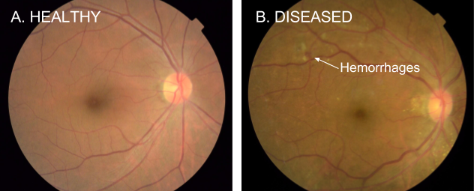
Diagnosing Diabetic Eye Disease Using Deep Learning
Diabetic retinopathy (DR) is the fastest growing cause of blindness, with nearly 451 million diabetic patients at risk worldwide
One of the most common ways to detect DR is to have a specialist examine eye pictures and rate them for disease presence and severity
Notes:
With diabetes comes complications, including diabetic retinopathy (DR), a condition caused by chronically high blood sugar that damages blood vessels in the retina, the thin layer at the back of the eye responsible for sensing light and sending signals to the brain. These blood vessels can leak or hemorrhage, causing vision distortion or loss.
DR is one of the leading causes of vision impairment in the world (5% of cases of blindness worldwide are caused by DR)
In early stages of DR, a patient often has no symptoms, making it important for people living with diabetes to be screened regularly, as this is the stage in which damage can be reversed— progression of DR can be stopped or significantly reduced by blood sugar control. Early detection is key to initiate timely treatment and mitigate the risk of blindness.
The shortage of doctors limits the ability to screen patients and also creates a treatment backlog for those found to have DR (e.g., ophthalmologists-to-patients ratio in Thailand is 1:3000, double of that in the USA)
Among individuals with diabetes, the prevalence of diabetic retinopathy is approximately 28.5%in the United States and 18% in India.

Slide 24
Diagnosing Diabetic Eye Disease Using Deep Learning
If DR is caught early, the disease can be treated; if not, it can lead to irreversible blindness
As such, regular screening is essential for the early detection of DR
Unfortunately, medical specialists capable of detecting DR are not available in many parts of the world where diabetes is prevalent
Google has developed a deep learning algorithm capable of interpreting signs of DR in retinal photographs

Slide 25
Diagnosing Diabetic Eye Disease Using Deep Learning
They created a dataset of 128,000 images, each labeled by 3-7 ophthalmologists from a panel of 54 ophthalmologists
DR severity (none, mild, moderate, severe, or proliferative) was graded according to the International Clinical Diabetic Retinopathy scale
They then used this dataset to train a deep learning algorithm to detect referable diabetic retinopathy
Afterwards, they tested the algorithm on two clinical validation sets totaling ~12,000 images, with a panel of 7-8 U.S. board-certified ophthalmologists serving as the reference standard
Notes:
The ophthalmologists selected for the validation sets were the ones that showed high consistency from the original group of 54 doctors.

Slide 26
Diagnosing Diabetic Eye Disease Using Deep Learning
The F-score (combined sensitivity and precision) of the algorithm was 0.95, which is slightly better than the median F-score of the 8 board-certified ophthalmologists (measured at 0.91)
Gold Standard
 | DR | No DR
DR
No DR
Predicted
by the classifier
A confusion matrix for visualizing how well a binary classifier (DR vs. No DR) performs against the ground truth (or gold standard)

Slide 27
Diagnosing Diabetic Eye Disease Using Deep Learning
The F-score (combined sensitivity and precision) of the algorithm was 0.95, which is slightly better than the median F-score of the 8 board-certified ophthalmologists (measured at 0.91)
Gold Standard
 | DR | No DR
DR | True Positive
No DR
Predicted
by the classifier

Slide 28
Diagnosing Diabetic Eye Disease Using Deep Learning
The F-score (combined sensitivity and precision) of the algorithm was 0.95, which is slightly better than the median F-score of the 8 board-certified ophthalmologists (measured at 0.91)
Gold Standard
 | DR | No DR
DR | True Positive
No DR
Predicted
by the classifier

Slide 29
Diagnosing Diabetic Eye Disease Using Deep Learning
The F-score (combined sensitivity and precision) of the algorithm was 0.95, which is slightly better than the median F-score of the 8 board-certified ophthalmologists (measured at 0.91)
Gold Standard
 | DR | No DR
DR | True Positive
No DR | False Negative
Predicted
by the classifier

Slide 30
Diagnosing Diabetic Eye Disease Using Deep Learning
The F-score (combined sensitivity and precision) of the algorithm was 0.95, which is slightly better than the median F-score of the 8 board-certified ophthalmologists (measured at 0.91)
Gold Standard
 | DR | No DR
DR | True Positive
No DR | False Negative
Predicted
by the classifier

Slide 31
Diagnosing Diabetic Eye Disease Using Deep Learning
The F-score (combined sensitivity and precision) of the algorithm was 0.95, which is slightly better than the median F-score of the 8 board-certified ophthalmologists (measured at 0.91)
Gold Standard
 | DR | No DR
DR | True Positive | False Positive
No DR | False Negative
Predicted
by the classifier

Slide 32
Diagnosing Diabetic Eye Disease Using Deep Learning
The F-score (combined sensitivity and precision) of the algorithm was 0.95, which is slightly better than the median F-score of the 8 board-certified ophthalmologists (measured at 0.91)
Gold Standard
 | DR | No DR
DR | True Positive | False Positive
No DR | False Negative
Predicted
by the classifier

Slide 33
Diagnosing Diabetic Eye Disease Using Deep Learning
The F-score (combined sensitivity and precision) of the algorithm was 0.95, which is slightly better than the median F-score of the 8 board-certified ophthalmologists (measured at 0.91)
Gold Standard
 | DR | No DR
DR | True Positive | False Positive
No DR | False Negative | True Negative
Predicted
by the classifier

Slide 34
Diagnosing Diabetic Eye Disease Using Deep Learning
The F-score (combined sensitivity and precision) of the algorithm was 0.95, which is slightly better than the median F-score of the 8 board-certified ophthalmologists (measured at 0.91)
Gold Standard
 | DR | No DR
DR | True Positive | False Positive
No DR | False Negative | True Negative
Predicted
by the classifier

Slide 35
Diagnosing Diabetic Eye Disease Using Deep Learning
The F-score (combined sensitivity and precision) of the algorithm was 0.95, which is slightly better than the median F-score of the 8 board-certified ophthalmologists (measured at 0.91)
Gold Standard
 | DR | No DR
DR | True Positive | False Positive
No DR | False Negative | True Negative
Predicted
by the classifier
% of correct cases (i.e., with DR) that are predicted as DR

Slide 36
Diagnosing Diabetic Eye Disease Using Deep Learning
The F-score (combined sensitivity and precision) of the algorithm was 0.95, which is slightly better than the median F-score of the 8 board-certified ophthalmologists (measured at 0.91)
Gold Standard
 | DR | No DR
DR | True Positive | False Positive
No DR | False Negative | True Negative
Predicted
by the classifier
% of correct cases (i.e., with DR) that are predicted as DR =
Recall = $\frac{True Positive}{True Positive+False Negative}$

Slide 37
Diagnosing Diabetic Eye Disease Using Deep Learning
The F-score (combined sensitivity and precision) of the algorithm was 0.95, which is slightly better than the median F-score of the 8 board-certified ophthalmologists (measured at 0.91)
Gold Standard
 | DR | No DR
DR | True Positive | False Positive
No DR | False Negative | True Negative
Predicted
by the classifier
The algorithm’s ability to designate an individual with DR as positive =
Recall = $\frac{True Positive}{True Positive+False Negative}$

Slide 38
Diagnosing Diabetic Eye Disease Using Deep Learning
The F-score (combined sensitivity and precision) of the algorithm was 0.95, which is slightly better than the median F-score of the 8 board-certified ophthalmologists (measured at 0.91)
Gold Standard
 | DR | No DR
DR | True Positive | False Positive
No DR | False Negative | True Negative
Predicted
by the classifier
The algorithm’s ability to designate an individual with DR as positive =
Recall = $\frac{True Positive}{True Positive+False Negative}$ = Sensitivity (which is the term used in medicine)

Slide 39
Diagnosing Diabetic Eye Disease Using Deep Learning
The F-score (combined sensitivity and precision) of the algorithm was 0.95, which is slightly better than the median F-score of the 8 board-certified ophthalmologists (measured at 0.91)
Gold Standard
 | DR | No DR
DR | True Positive | False Positive
No DR | False Negative | True Negative
Predicted
by the classifier
% of predicted cases (i.e., with DR) that are correct

Slide 40
Diagnosing Diabetic Eye Disease Using Deep Learning
The F-score (combined sensitivity and precision) of the algorithm was 0.95, which is slightly better than the median F-score of the 8 board-certified ophthalmologists (measured at 0.91)
Gold Standard
 | DR | No DR
DR | True Positive | False Positive
No DR | False Negative | True Negative
Predicted
by the classifier
% of predicted cases (i.e., with DR) that are correct =
Precision = $\frac{True Positive}{True Positive+False Positive}$

Slide 41
Diagnosing Diabetic Eye Disease Using Deep Learning
The F-score (combined sensitivity and precision) of the algorithm was 0.95, which is slightly better than the median F-score of the 8 board-certified ophthalmologists (measured at 0.91)
Gold Standard
 | DR | No DR
DR | True Positive | False Positive
No DR | False Negative | True Negative
Predicted
by the classifier
F1-measure = $\frac{2(Recall×Precision)}{Recall +Precision}$

Slide 42
Diagnosing Diabetic Eye Disease Using Deep Learning
The F-score (combined sensitivity and precision) of the algorithm was 0.95, which is slightly better than the median F-score of the 8 board-certified ophthalmologists (measured at 0.91)
Gold Standard
 | DR | No DR
DR | True Positive | False Positive
No DR | False Negative | True Negative
Predicted
by the classifier
Captures the tradeoff between recall and precision; the higher the better
F1-measure = $\frac{2(Recall×Precision)}{Recall +Precision}$

Slide 43
Diagnosing Diabetic Eye Disease Using Deep Learning
The F-score (combined sensitivity and precision) of the algorithm was 0.95, which is slightly better than the median F-score of the 8 board-certified ophthalmologists (measured at 0.91)
Gold Standard
 | DR | No DR
DR | True Positive | False Positive
No DR | False Negative | True Negative
Predicted
by the classifier
The algorithm’s ability to designate an individual with No DR as negative =

Slide 44
Diagnosing Diabetic Eye Disease Using Deep Learning
The F-score (combined sensitivity and precision) of the algorithm was 0.95, which is slightly better than the median F-score of the 8 board-certified ophthalmologists (measured at 0.91)
Gold Standard
 | DR | No DR
DR | True Positive | False Positive
No DR | False Negative | True Negative
Predicted
by the classifier
The algorithm’s ability to designate an individual with No DR as negative =
Specificity = $\frac{True Negative}{True Negative + False Positive}$

Slide 45
Diagnosing Diabetic Eye Disease Using Deep Learning
The F-score (combined sensitivity and precision) of the algorithm was 0.95, which is slightly better than the median F-score of the 8 board-certified ophthalmologists (measured at 0.91)
What does this study entail?
AI can now offer an automated system for DR detection with
A very high accuracy
Near instantaneous reporting of results!
Consistency of interpretation (the algorithm will make the same prediction on the same image every time)

Slide 46
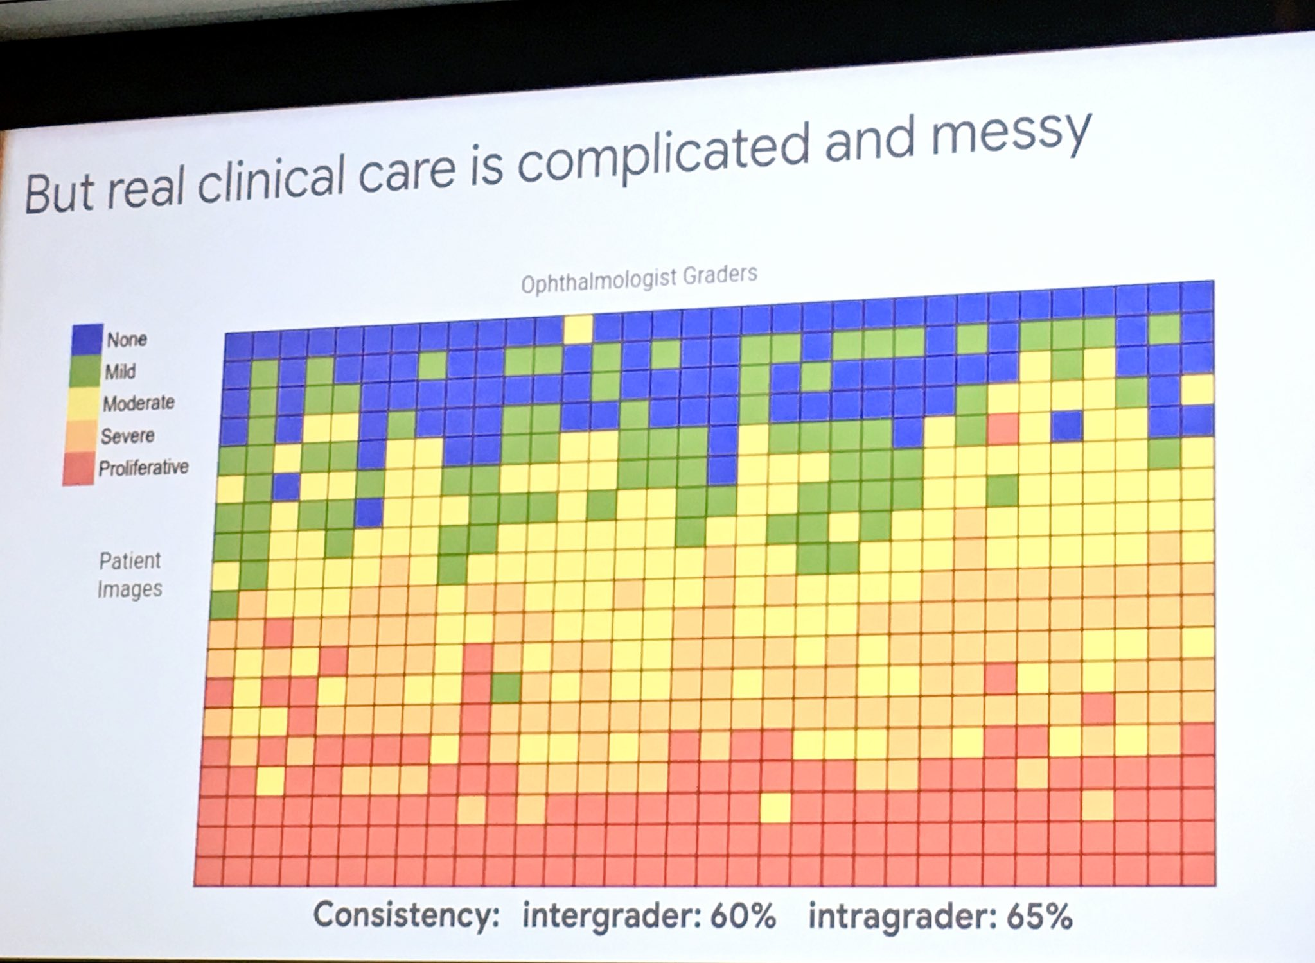
Diagnosing Diabetic Eye Disease Using Deep Learning
A slide from Jeff Dean’s Keynote in 2019 at the “Big Data in Precision Health” conference at Stanford Medicine

Slide 47
Some Applications of AI in Medicine
Diagnosing diabetic eye disease using deep learning [1]
Detecting anemia from retinal fundus images using deep learning [2]
Predicting cardiovascular risk factors from retinal fundus photographs using deep learning [3]
Performing differential diagnosis using probabilistic graphical models [4]
Extracting symptoms and their status from clinical conversations using recurrent neural networks [5]
Predicting osteoarthritis using machine learning [6]
Next lecture…

Slide 48
Thank you!

Slide 49
References
Gulshan, Varun, et al. "Development and validation of a deep learning algorithm for detection of diabetic retinopathy in retinal fundus photographs." Jama 316.22 (2016): 2402-2410.
Mitani, Akinori, et al. "Detection of anaemia from retinal fundus images via deep learning." Nature Biomedical Engineering 4.1 (2020): 18-27.
Poplin, R., et al. "Predicting cardiovascular risk factors from retinal fundus photographs using deep learning.” arXiv preprint arXiv:1708.09843.
Hammoud, M., et al. “Avey: An Accurate AI Algorithm for Self-Diagnosis.” medRxiv 2022
Du, Nan, et al. "Extracting symptoms and their status from clinical conversations." arXiv preprint arXiv:1906.02239 (2019).
Kundu, Shinjini, et al. "Discovery and visualization of structural biomarkers from MRI using transport-based morphometry." NeuroImage 167 (2018): 256-275.

